Slide 1
Worksheet Results
[Company] Playbook
Date (if applicable)
@NVBC | newventuresbc.com

Slide 2
Introduction
This deck contains all of the worksheets associated with the Market Validation Training Program that you are enrolled in.
Download and print individual worksheets as you progress through the online lessons. Once you have completed the worksheet, transfer the completed responses to the appropriate slide in this deck. By the end you will have completed your full Go To Market strategy for your venture.
You’ll also find a sample pitch deck at the end of the worksheets. You can complete that from the work you have documented in the previous slides and use that for your future presentations to key stakeholders, such as investors, partners and employees.
Good luck, and have fun!

Slide 3
Business Model Canvas
Key Partners
Key Activities
Value Proposition
Customer Relationships
Customer Segments
Top Partners
Top Activities
Value Proposition
Describe
Primary
Key Resources
Channels
Top Resources
Cost Structure
Revenue Streams

Slide 4
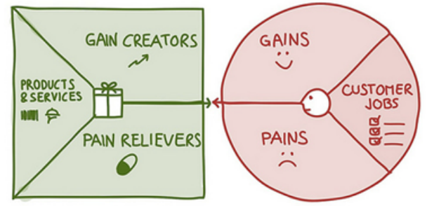
Value Proposition Canvas
Products & Services
Gain Creators
Gains
Customer Jobs
Pain Relievers
Pains

Slide 5
Day in the Life of my Customer
What does she THINK AND FEEL?
worries, aspirations
What does she HEAR?
Friends, boss, colleagues, influencers
Insert image of target buyer
What does she SEE?
Environment, colleagues, events, other products?
What does she SAY and DO?
Attitudes, appearance
Persona Name:
Age:
Gender:
Title:
Years of work:
Family Status:
Other Fun Facts…
PAINS
Her fears, frustrations, obstacles?
GAINS
Her wants/needs, success metrics
* Duplicate slide for each buyer type

Slide 6
Market Segmentation
INDUSTRY or MARKET
SECTOR SUB-SECTOR SIZE GEOGRAPHY
SWEET SPOT MARKET SIZE =
Notes:
While the above breakdown is common, you may get better segmentation by switching the order, for example: sub-sector, geography & size, instead of the above. Many other breakdowns are possible, e.g., segment, sub-segment, geography, income level, age, education level, etc.
You may be able to get away with using fewer columns to get an adequate segmentation. Sometimes you may need to add another one.

Slide 7
Segmentation
IDEAL CUSTOMER CHARACTERISTICS
Criteria #1:
Criteria #2:
Criteria #3:
Criteria #4:
Criteria #5:
Note: It may be useful to identify the characteristics of the user, user manager, technical buyer & economic buyer. Replicate the above template as required.

Slide 8
Business Hypothesis
MARKET TYPE
Our Market Type is (choose one):
Clone
Existing
Resegmented
New
Characteristics of our market:

Slide 9
Customer Notes
CUSTOMER NAME #1:
Summarize key things that you learned from first customer meeting
#1 Pain they are experiencing:
#1 Benefit they would get by addressing pain point:
#1 Feature they need to get the benefit:
#1 Competitor to your solution and their differentiator:
Note: Repeat these Customer Notes slides for each user or prospective user that you speak with.

Slide 10
Customer Discovery Findings
KEY FINDINGS FROM FIRST CUSTOMER MEETINGS:
Text
Text
Text
LIKES:
DISLIKES:

Slide 11
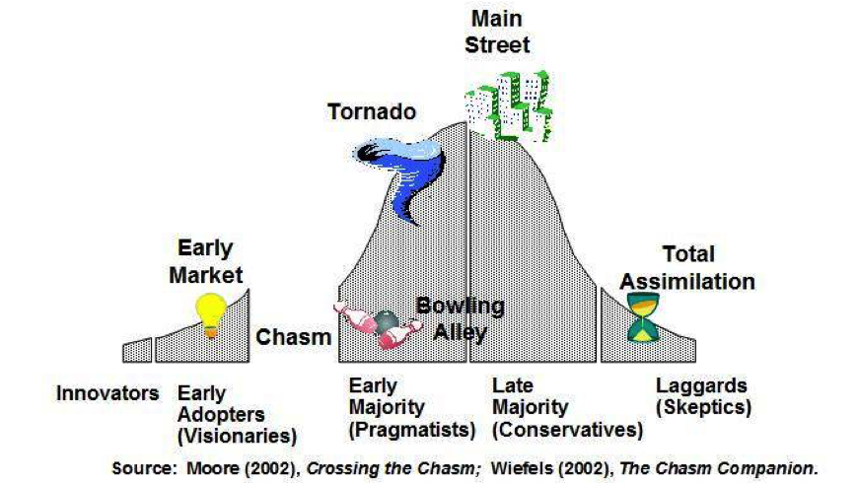
TALC
Where Are You? (choose one):
Innovators
Early Market
Chasm
Bowling Alley
Tornado
Main Street
Total Assimilation
Define the top thing you must do to move to the next stage in the TALC? Remember that your market type will determine the width of your chasm:

Slide 12
Opportunity Assessment: Insert Market Name
Market Potential Attributes |  | Score |  | Market Challenge Attributes |  | Score
Compelling reason to buy |  | Avg |  | Implementation Obstacles |  | Avg
Unmet need | * | ** |  | Product development difficulties | * | **
Effective solution | * | ** |  | Sales & distribution difficulties | * | **
Better than current solutions | * | ** |  | Funding challenges | * | **
Market Volume |  | Avg |  | Time to revenue |  | Avg
Current market size | * | ** |  | Development time | * | **
Expected growth | * | ** |  | Time between product and market readiness | * | **
 |  |  |  | Length of sales cycle | * | **
Economic viability |  | Avg |  | External risks |  | Avg
Margins | * | ** |  | Competitive threat | * | **
Customers' ability to pay | * | ** |  | 3rd party dependencies | * | **
Customer stickiness | * | ** |  | Barriers to adoption | * | **
Average score |  | Avg |  | Average score |  | Avg
* Choose Low/Mid/High/Super
** Low = 1, Mid = 2, High = 3, Super = 4
Notes:
You can aggregate your assessment on a table to develop a Market Potential Score and a Market Challenge score for each market. In this case for the Alpha market. In this case we have just used a scale of 1, 2, 3, and 4 to represent Low, mid, high and Super high respectively. Simple averages without weighting have been used. Most importantly record your assumptions and facts you used to come to your assessment so that you can periodically review these to test that they are still valid.

Slide 13
Market Attractiveness Map
Gold Mine
Moon Shot
Insert and your markets
Low Mid High Super Hi
Insert your markets
Potential
Quick Win
Questionable
Insert your markets
Low Mid High Super Hi
Challenge
Notes:
Once each of the different Market applications have been assessed, in this case Alpha, Beta, Delta Omega and Theta, you can plot them on your Market Attractiveness Map. In this case Beta looks like a Quick Win however we believe that Alpha is a better first market choice because it offers significantly more opportunity for marginally extra challenge or risk.
However we are attempting to look into the future so our knowledge is not complete, we want to focus on Alpha and either eliminate other markets for now or keep some open as options if circumstances change.

Slide 14
Prioritizing Opportunities
Primary Market | Insert Market Name
Secondary Markets | Insert Market Name | Insert Market Name | Insert Market Name | Insert Market Name
Market Relatedness | Rank High/Medium/Low
Product Relatedness | Rank High/Medium/Low
Type of option/alternative | Rank Backup/growth
When to Consider | Rank Pursue Now/ Keep Open / Store for Future
High
Medium
Low
Notes:
Once we have considered the Product and Market Relatedness you can place them on a chart to consider whether the market alternatives are a Backup market for the current choice to pursue if market circumstances change or are they a future growth option? Secondly should they be considered now or in the future? In this case we have kept Beta (the Quick Win) open for now as a backup option. Delta, the Moon Shot has be put aside for now as a future growth option that we may be able to de-risk once we are in the market.

Slide 15
Product Management
RELEASE #1 (MVP) | RELEASE #2 | LATER
1.
2.
3.
4.
5.
Note: Identify the key features that need to be part of your first and second product release. Everything else goes into the “later” category.

Slide 16
Competitive Landscape
High
Feature #1
Lo
High
Lo
Feature #2

Slide 17
Total Addressable Market
MARKET EXPECTATIONS
Measure | # of Units | X | Price Per Unit | = | Total Revenue
Total Market
Total Addressable Market (TAM)
Year 1 Revenue
Year 2 Revenue
Year 3 Revenue

Slide 18
Customer Journey Data Mapping: Stage Definitions
Customer Journey Stage | Awareness | Consideration | Decision (Trial) | Engagement | Advocacy | Expansion
Customer Thought Process
Company Thoughts Process
Targets
KPI

Slide 19
Customer Journey Data Mapping: Channels
In each box place a bullet on the tactic you will use, if applicable
Select the channel(s) you would like to use for every stage of customer journey
Channel | Awareness | Consideration | Decision (Trial) | Engagement | Advocacy | Expansion
Website
SEO
Email
Social Media
Media Buys / Paid Search
Blog
Video
Webinar
Earned Media
Events
Other

Slide 20
Sales Funnel (Direct Sales)
LEAD GENERATION ACTIVITIES (Cold Calls, Website, LinkedIn, Facebook, Referrals etc.)
Our Sales Stages
1. Interested Exit Criteria: | (i.e. Telephone conversation, Demo)
2. Qualified Exit Criteria: | (i.e. confirmed need, budget, timeline, authority)
3. Selected Exit Criteria: | (i.e.: draft contract / term sheet)
4. Closed Exit Criteria: | (i.e.: signed contract)
Interested
Qualified
Selected
Closed
Note: Insert your exit criteria. For D2C is could include website visit, email signup, trial account created, subscription etc.

Slide 21
Conversion Rate by Stage
Our Sales Stages
Sales Stage | Conversion Rate | Count
Leads via marketing activities |  | 3030
Thru marketing to Interested | 3.3 % | 100
From Interested to Qualified | 10 % | 10
From Qualified to Selected | 20 % | 2
From Selected to Closed | 50 % | 1
Note: Add your expected conversion rates and forecasted sales.

Slide 22
Presentation Template
Pitch Deck
Suggested format to keep investors and other stakeholders happy and awake.
@NVBC | newventuresbc.com

Slide 23
Investor Pitch Template
Must “grab” in first 2 minutes, 3 slides.
Consider using your “Dead Lobster” here
Use your storytelling capabilities
The better the story, the more memorable, and the more repeatable
NOTE :
Average entrepreneur pitch – 38 slides
Average VC attention span – 12 slides, 15 mins
Move all non-essential slides to Appendix

Slide 24
Executive Summary
“New Co.” is what you are specializing in doing for specific customers.
Our special sauce gives us a unique advantage that will capture X% of $X market.
We will be looking for $X to build an enabling function that will generate $X over X months.
Note: < 20% of presenters do this well

Slide 25
The Problem
Describe the problem in simple, clear, concise terms.
Current state & seriousness of problem.
Desired future state, benefit to customer.
Scale of the initial market (use extra slide if necessary).
No more than 6 bullets.
Graphics better than words.
Note: < 10% of presenters do this well

Slide 26
Your Solution
Describe your solution in simple, clear, concise terms.
Key benefits, features.
Product roadmap.
No more than 6 bullets.
Graphics better than words.
Note: < 70% of presenters do this well

Slide 27
The Business Model
Explain how you are going to make money - clear, concise (If you can’t describe your business model in 20 words or less, you probably don’t have a workable model).
What’s the value to the customer?
Customer Value = (Seriousness of Current State + Benefits of Desired Future State) ­ Cost of the Solution
Pricing Strategy / Revenue Model
Bottom up is better than top down

Slide 28
What is Your Special Sauce?
What’s the proprietary, underlying “magic” that gives you a clear, defensible advantage?
Patents on their own are rarely sufficient.
What are you going to do particularly well that it will be difficult to copy? Your “unfair advantage”.
Graphics better than words.
Note: < 30% of presenters do this well

Slide 29
How are you going to Market and Sell?
Describe your Marketing & Sales strategies in simple, clear, concise terms.
1 or 2 marketing strategies.
Sales cycle & strategy for initial market.
No more than 6 bullets.
Graphics better than words.
Note: < 50% of presenters do this well

Slide 30
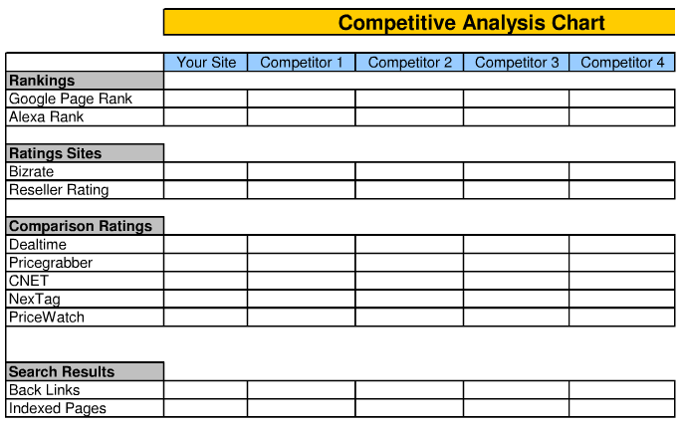
Competition
There is ALWAYS competition – even if it’s the way it’s done now.
Provide a Competitive Analysis: a table/chart comparing your solution to the current approach & major competitors, by key benefit.
The more realistic you are, the more believable your case.
Note: < 30% of presenters do this well

Slide 31
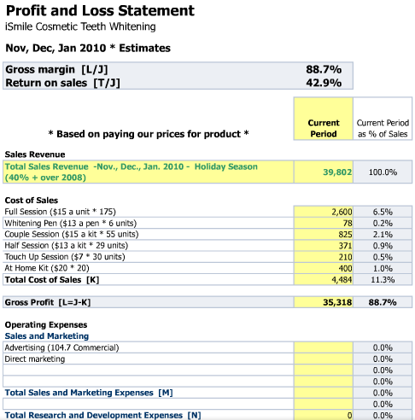
Financial Projections
Profit and Loss Statement
Bottom up better than top down.
Assumptions more important than numbers.
Be prepared to explain.
Note: < 10% of presenters do this well

Slide 32
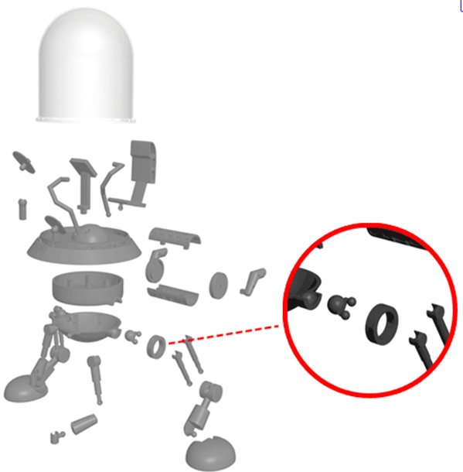
Status and Timeline
Major Milestones:
What’s been achieved to date.
What you’re going to use the money for.
When you expect to break even.
Any additional funding.
Include expected liquidity event & potential buyers.
Can display using a timeline
Completed for $100,000 June 2019
Need $1 M to Complete by
October 2020
Note: < 30% of presenters do this well

Slide 33
Summary / Ask
The top 2 or 3 things you want audience to remember, or the Call To Action
No more than 3 bullets
Note: Most presenters don’t do this at all

Slide 34
Appendices
Have details ready for when you are asked.
Team biographies
Advisors (lawyers, accountants, mentors, etc.)
Financing history, existing investors, etc.
Past year end financial statements (interim financials if available)
Technical details including product stage timeline and regulatory issues
Market research conducted
Competition
Sales and marketing strategies and tactics
Traction: Who are your existing customers
Testimonials
Location of the company and why
Intellectual property details
Human resource strategy (next hires)

