Slide 1
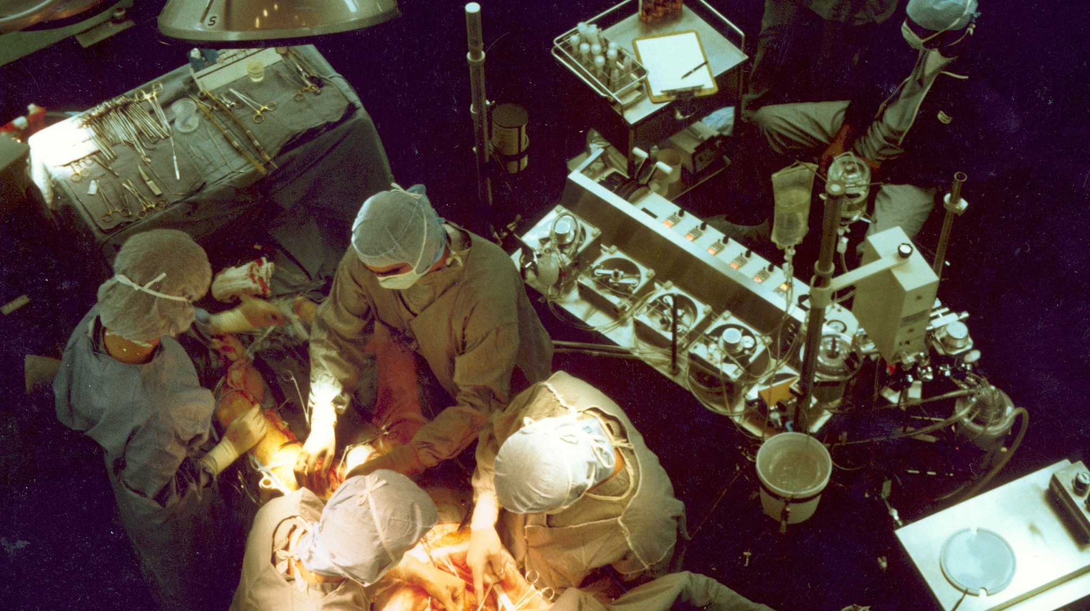
HEART LUNG MACHINE
SOURCE: https://en.wikipedia.org/wiki/Cardiopulmonary_bypass#/media/File:Coronary_artery_bypass_surgery_Image_657C-PH.jpg
1

