Slide 1
Product/Market Fit
“Product Marketing Overview”

Slide 2
Dave Thomas 604-603-8630
dthomas@rocketbuilders.com
www.rocketbuilders.com
Ready to Rocket and Emerging Rockets
Past NVBC award winners
http://www.readytorocket.com/

Slide 3

Sailing School at Jericho Beach
www.macsailing.com dave@macsailing.com
Shenzhen Sun Sailing, Shenzhen China http://www.sunsailing.net/page/Default.asp?pageID=16

Slide 4

Marketing Research & Segmentation
Understanding Consumers
‘Whole’ Solution Offerings
Product Positioning
Metrics
Answer Questions: 1, 5, 6, 7, 8, 9

Slide 5
Successful Growth Companies
Minimum Viable Product evolves to become……
… the product demanded by the market including a viable revenue model
Addressable market with an ‘engine of growth’ or a clearly defined niche market
Product
Revenue
Market

Slide 6
Market Research

Slide 7
Why Segment?
Focuses scarce marketing & development resources on target customer group
Narrows whole product definition
Limits real competitors
Leverages past success into other segments
Allows the benefits of market leadership to develop more quickly

Slide 8

Value Proposition
“Whenever you get confused… go to the store… the customer has all the answers… and all the money.”
—Sam Walton
Founder Wal-Mart
Value of Your Offering
Value Offered by Competitors

Slide 9
Markets, Pains & Requirements
Markets
  Size
  Trends
  Segments
Pains
  Customer Pain
  Value Chain Pain
Requirements
  Customer Requirements
  Channel Requirements

Slide 10
Market Segmentation
Revolutionary Products
  Segment originates with technology or product
  Vendors can’t predict next innovation or its consequences
Evolutionary Products:
  Segment is pre-defined; challenge is to refine definition/redefine
  Mainstream market customers insist vendors fit solution to their problem

Slide 11
Why? - Marc Andreessen
What’s most dangerous, a bad team, a weak product or a poor market?
The # 1 company killer is lack of market
Getting to product/market fit really matters

Slide 12
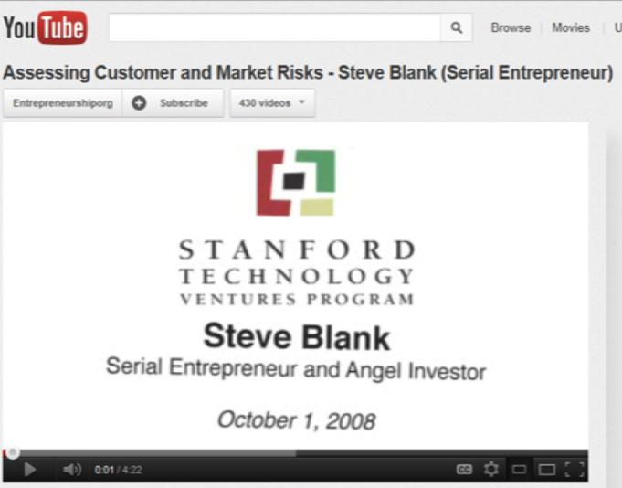
Why? - Steve Blank

Slide 13

Blank - Hypotheses versus Reality
Large companies execute in a market
Start-ups ‘search’ for a business model
Build, Measure, Learn
  Make a prediction, ship, measure the results, repeat and then see what happens again
  Prove that your product fits the market - Reality

Slide 14
Top Down Versus Bottom-up
Revenue is NOT a function of market share, size, and penetration rates
($ 1B market x 2% penetration = $20 M)
Revenue IS a function of the leads you attract, conversion rates, price and individual customers
L x % x P = R

Slide 15
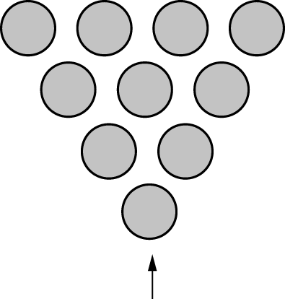
Top Down is Valuable
Total addressable market (TAM) is a term that is typically used to reference the revenue opportunity available for a product or service.
  Theoretical Market
  Potential Market
  Available Market
  Addressable Market
  Target Market
  Market Demand
Notes:
Not market size
$ 18 B market for coffee in NA
I open a coffee shop

Slide 16
Bottom-up – The Market
Target markets are groups of individuals separated by distinguishable and noticeable aspects.
  Available Budgets
  Market Reach
  Attach Rate
  Conversion Rate
  Win Rate

Slide 17
Bowling Alley Model – Headpin Segment
”Target a single niche market segment
with a ‘must-have’ value proposition”
(In Bowling Alley)
Identify a segment you can dominate
Win market share leadership in that segment
Leverage leadership to win over adjacent segments

Slide 18
Understanding the Market
Internal Focus External Focus
Product & Feature Customer Value
Lots of Features Differentiation
Reactive R&D Headpin Segment
Unpredictable Results Reliable Customers

Slide 19
SECONDARY RESEARCH | PRIMARY RESEARCH
Internet, books, articles | Face to face, surveys
Free or easily purchased e.g. StatsCan/Census | Cost investment (time or money)
Fast | Less fast
Broad strokes | Targeted
Available to all | For your eyes only

Slide 20
Technology Adoption Cycle
Provides an understanding of customer requirements e.g. Why buy? What’s in it for me/us?
Establishes focus for and timing of marketing strategy. How and when to execute marketing activities.

Slide 21
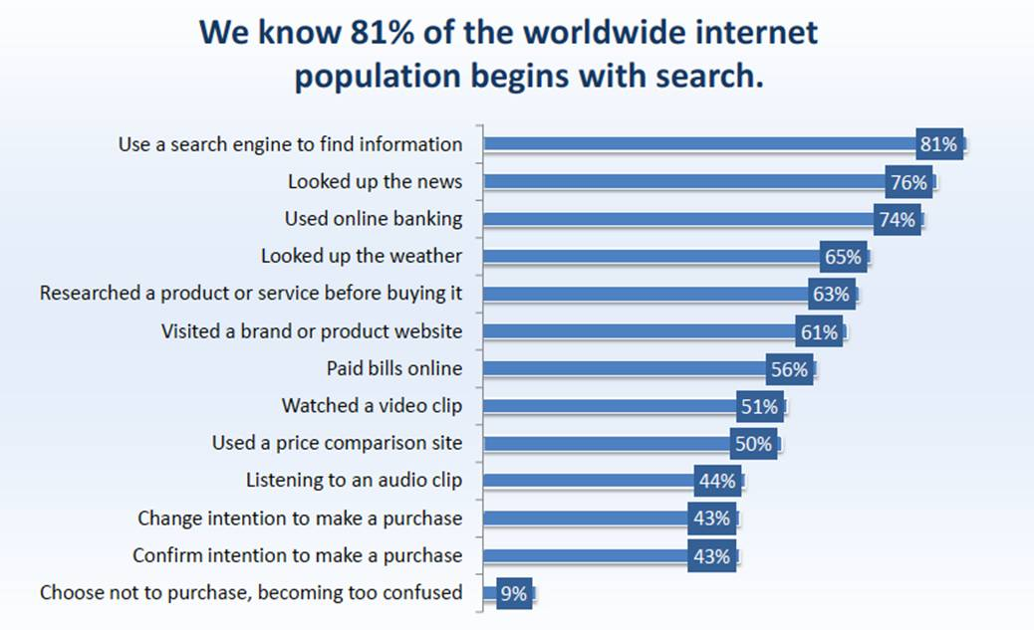
Buyer Internet Behaviour

Slide 22
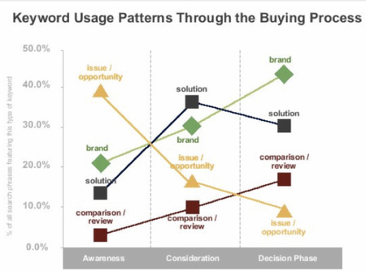
Role of Search in Buyer’s Process

Slide 23
How many people are involved?
“Business Technology Buyers Survey”
Size of Buying Organization | Participants in Buying Process
100 to 500 employees | 6.8
501 to 1000 employees | 13.5
Over 1000 employees | 21.0

Slide 24
Participants in Buying Process
Users
  are members of the organizations who will use the product or services. In many cases, users initiate the buying proposal and help define the product specifications.
Influencers
  often help define specifications and also provide information for evaluating alternatives. Technical personnel are particularly important influencers.
Buyers
  have formal authority to select the supplier and arrange terms of purchase. Buyers may help shape product specifications, but their major role is in selecting vendors and negotiating.
Deciders
  have formal or informal power to select or approve the final suppliers. In routine buying, the buyers are often the deciders, or at least the approvers.
Gatekeepers
  control the flow of information to others. For example, purchasing agents, often have authority to prevent salespersons from seeing users or deciders.

Slide 25
Segmentation 101
Do you need to build every feature potential customers ask for?
Why or why not?
Is differentiation based only on your product?

Slide 26
Building a Competitive Matrix
 | Us | Competitor 1 | Competitor 2
Largest Customers
Key Partners
Financial Health
Market Share
Key Products
Pricing
Key Product Features
Value Proposition
Sales Channels
Notes:
Many companies do this wrong … they compare their features, and often the features they care about, not the ones the customers care about

Slide 27
Whole Product

Slide 28
Whole Product Definition
Physical Product
+
All Associated Factors
(services, partners, warranties, guarantees, image, training, etc.)
=
“The Whole Product”
Both tangible & intangible elements required by target customer to solve his/her whole problem.

Slide 29

The Whole Product
Consulting
Hardware
Post-sales
service
& support
Software
Core
Product
Complementary
Services
Complementary
Products
Pre-sales
services
Peripherals
Legacy
interfaces
Connectivity,
SI
All other products, services and relationships needed by the target customer to fulfill their compelling reason to buy
Source: Crossing the Chasm, Geoffrey Moore

Slide 30
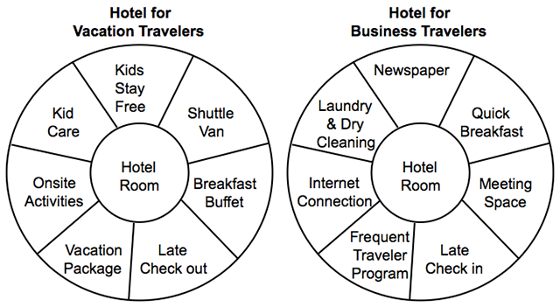
Hotels – Whole Product
Whole Product

Slide 31
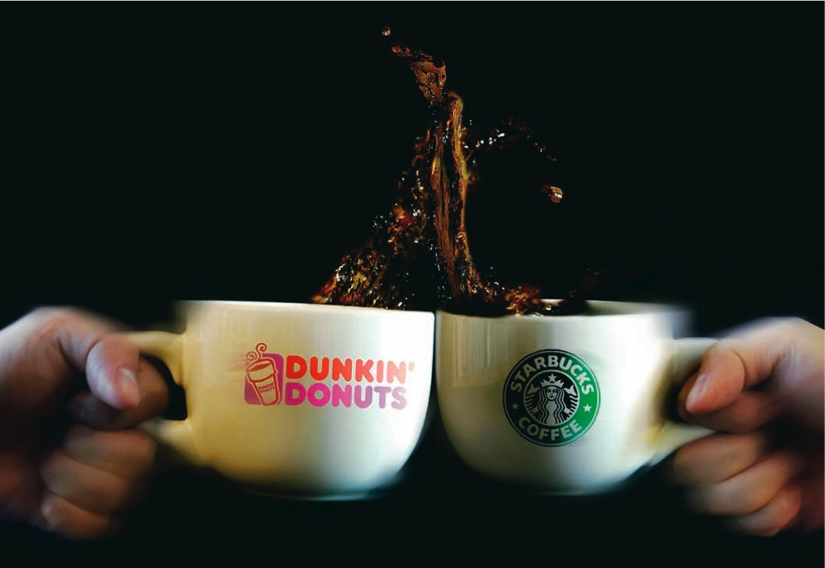
Coffee Example

Slide 32
Positioning

Slide 33
Definition
Why will they buy from us vs. our competition?
Positioning = Managing the product and its presentation to fit a predetermined place in the mind of the customer
Positioning = Market + Competitive Segmentation Differentiation

Slide 34
More Definitions…..
Perceived status within market segment. (Exists in people’s heads)
Build relationships to secure & communicate competitive advantage. (Something marketing folks do)

Slide 35
Positioning Impact
Partnerships
Competition
Pricing
Company Valuation
Product Position
Whole Product
Distribution
Service/Support
Sales Cycle

Slide 36
Positioning Process
Market Research
Market Segmentation
Demographics
Psychographics
Channels
Competitive Differentiation
Understand
Choose
Differentiate
Positioning Statement
Marketing Plan
Target Accounts
Product Launches
Test
Put stake in the ground
Reinforce in market

Slide 37
Product Positioning – How You Describe Your Product To Potential Customers
Customer: Who do we / could we sell to?
Need: What problem is our customer trying to solve, or opportunity to address?
Products: What do we / could we sell to meet our customer’s need?
Differentiation: Who else can address our customers’ needs. How are we different?
Whole Product: What else is needed to get a solution to the problem?
Positioning Statement Development.
Notes:
A critical task
Developing a polished product position is going to be an important activity in this program
I am suggesting you start this effort now with a straw-man position
Provides a very effective means to describe the product in terms a customer wants to hear
Can refine it as you proceed and gain feedback from customers

Slide 38
The Positioning Statement
Positioning Criteria:
  Who is the target customer? Is this the decision maker?
  What is the compelling reason to buy?
  What is the product category?
  What is the key benefit of that product category?
  Who is the main competitor?
  What is the key differentiation of this product?
Positioning Statement:
  For (target customer)
  Who (compelling reason to buy)
  Our product is a (product category)
  That (key benefit)
  Unlike (main competitor)
  Our product (key differentiation)

Slide 39
Positioning Example: Apple iPod
  For mobile, high-income individuals
  who need a way to listen to their entire music collection in different settings
  the Apple iPod is a small, portable digital music player
  that offers elegance of design, the ability to store an entire music collection, and easy purchasing of new digital music.
  Unlike flash mp3 players (Creative, Rio, etc),
  the product stores an entire music library and is integrated into a service to purchase new digital music (iTunes)
Notes:
Penetration: 47% of all mp3 players (NPD Group)
- 344% growth last year
Differentiated on style
Able to store an entire music collection
Closely integrated with a service to purchase new digital music (iTunes)
Price: $249-599
Early competitors: Rio,

Slide 40
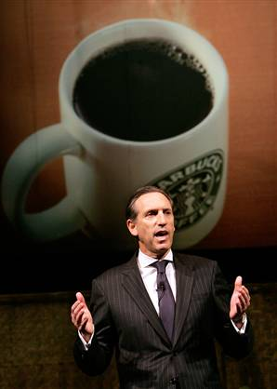
EXAMPLE FROM 1985 - Starbucks
For: Sophisticated coffee drinkers
Who: value excellent coffee and an amazing customer experience
The: Starbucks experience is a unique retail chain
That: adds to the quality of coffee-drinkers’ lives.
Unlike: Drip coffee served in a plastic cup
At Starbucks: we’re making coffee a new way and providing a unique environment for drinking it

Slide 41
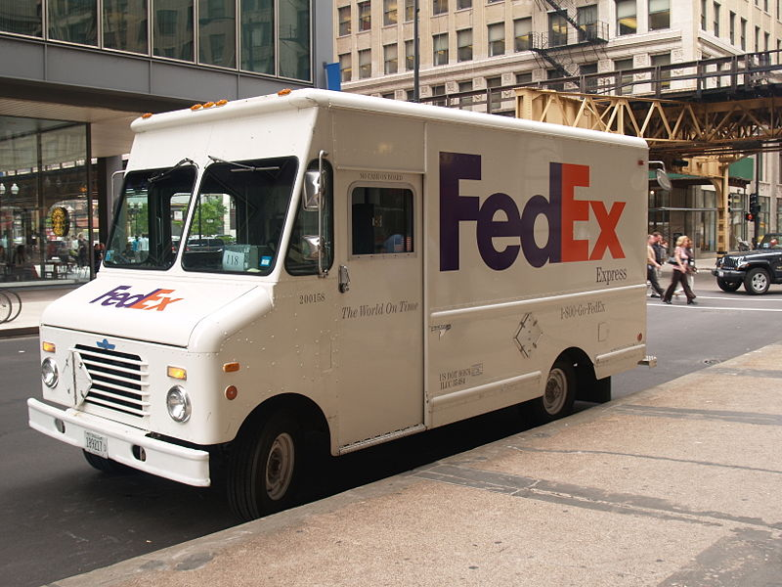
  Market Category?
  Brand Promise?
  Tagline?
  Differentiation?
  Positioning?
Notes:
“When it Absolutely, Positively has to be there overnight” – 1978–1983
“It’s not Just a Package, It’s Your Business” – 1987–1988
“Our Most Important Package is Yours” – 1991–1994
“Absolutely, Positively Anytime” – 1995
“The Way the World Works,” 1996–1998
“Be Absolutely Sure,” 1998–2000
“This is a Job for FedEx,” 2001–2002
“Don’t worry, there’s a FedEx for that,” 2002–2003
“Relax, it’s FedEx,” 2004–2008
"We Understand," 2009–present
"We Live To Deliver" 2009–present
"Brown Bailout" 2009–present
"The World On Time" 2009–present

Slide 42
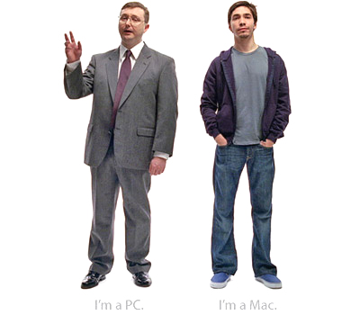
Competitive Examples
Apple Macintosh versus Windows/PC

Slide 43
Acid Test for Product Positioning
(ask yourself the following)
Can competitor’s product name be substituted?
Is there a relationship between compelling reason to buy and key differentiator?

Slide 44
Pricing & Value

Slide 45
Common Pricing Issues
  What are some common price objections you hear? Is your price too high or too low?
  How does you pricing model compare with the industry? With your competition?
  Do you offer promotional pricing? How effective is it?
  What licensing alternatives do you offer?
  What discounts do you provide to resellers?

Slide 46
Pricing 101
Do you need to have the lowest price to compete when you enter the market?

Slide 47
Product Marketing

Slide 48
Great Internet Tools – Use more than One
Alexa
Google Analytics
Microsoft adCenter Labs
Google AdWords Keyword tool
Unbounce
Kissmetrics
Hubspot
Hootsuite

Slide 49
Metrics & Analytics

Slide 50
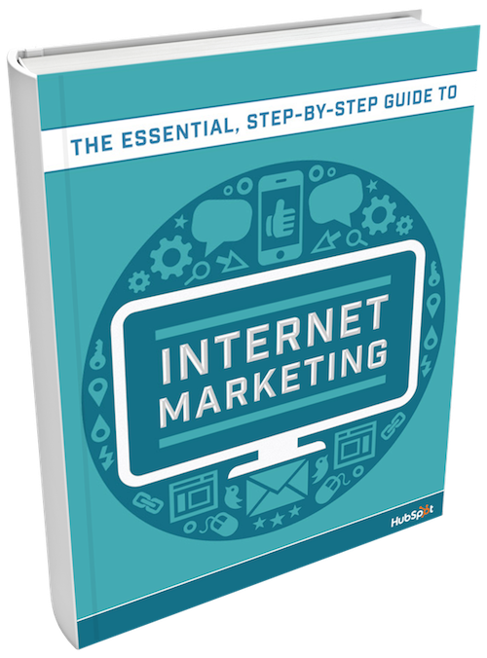

Slide 51
Hubspot eBook 160,000 Copies
6 essential steps to internet marketing success:
  Optimizing Your Website
  Creating Content
  Implementing a Social Strategy
  Converting Visitors into Leads
  Nurturing Leads into Customers
  Analyzing & Refining Data

Slide 52
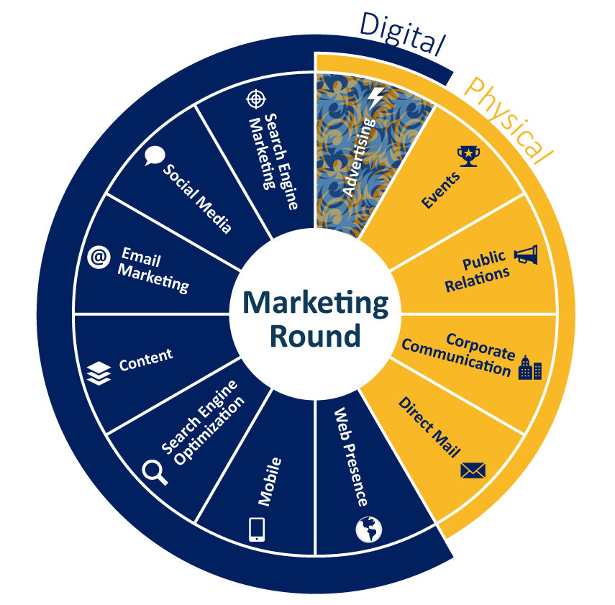
Range of Marketing Methods
Which fit your Market and why

Slide 53
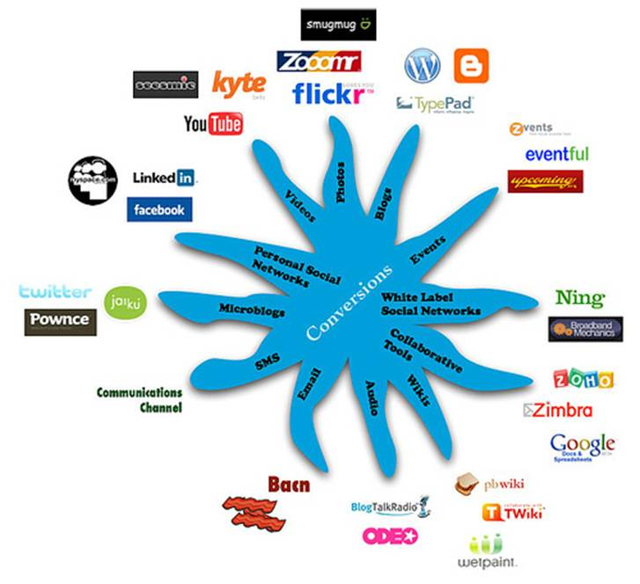
Social Media Platform Tools

Slide 54
B2B Social Media Marketing
93% of all B2B marketers are engaged in some form of social media marketing
  with most putting their focus on the most popular channels
    LinkedIn
    Facebook
    Twitter
    Instagram
Source: BtoB Magazine

Slide 55


















Top Tools in the B2B Toolkit
Social Platforms
Publishing
Networking
Sharing
Discussion

Slide 56
What Type of Company are you Building?
They are not all the same!
Most start-ups turn into small businesses
Most start-ups are not scalable
Most can emulate a business model
Most are not disruptive (10x rule)
Each will market via the Internet
Credit: Kevin Swan, iNovia Capital

Slide 57
Customer Validation Metrics
Average order size
Customer lifetime value
Average time to first order
Rate of sales pipeline growth
Improvement in close rate
Revenue per salesperson or employee

Slide 58
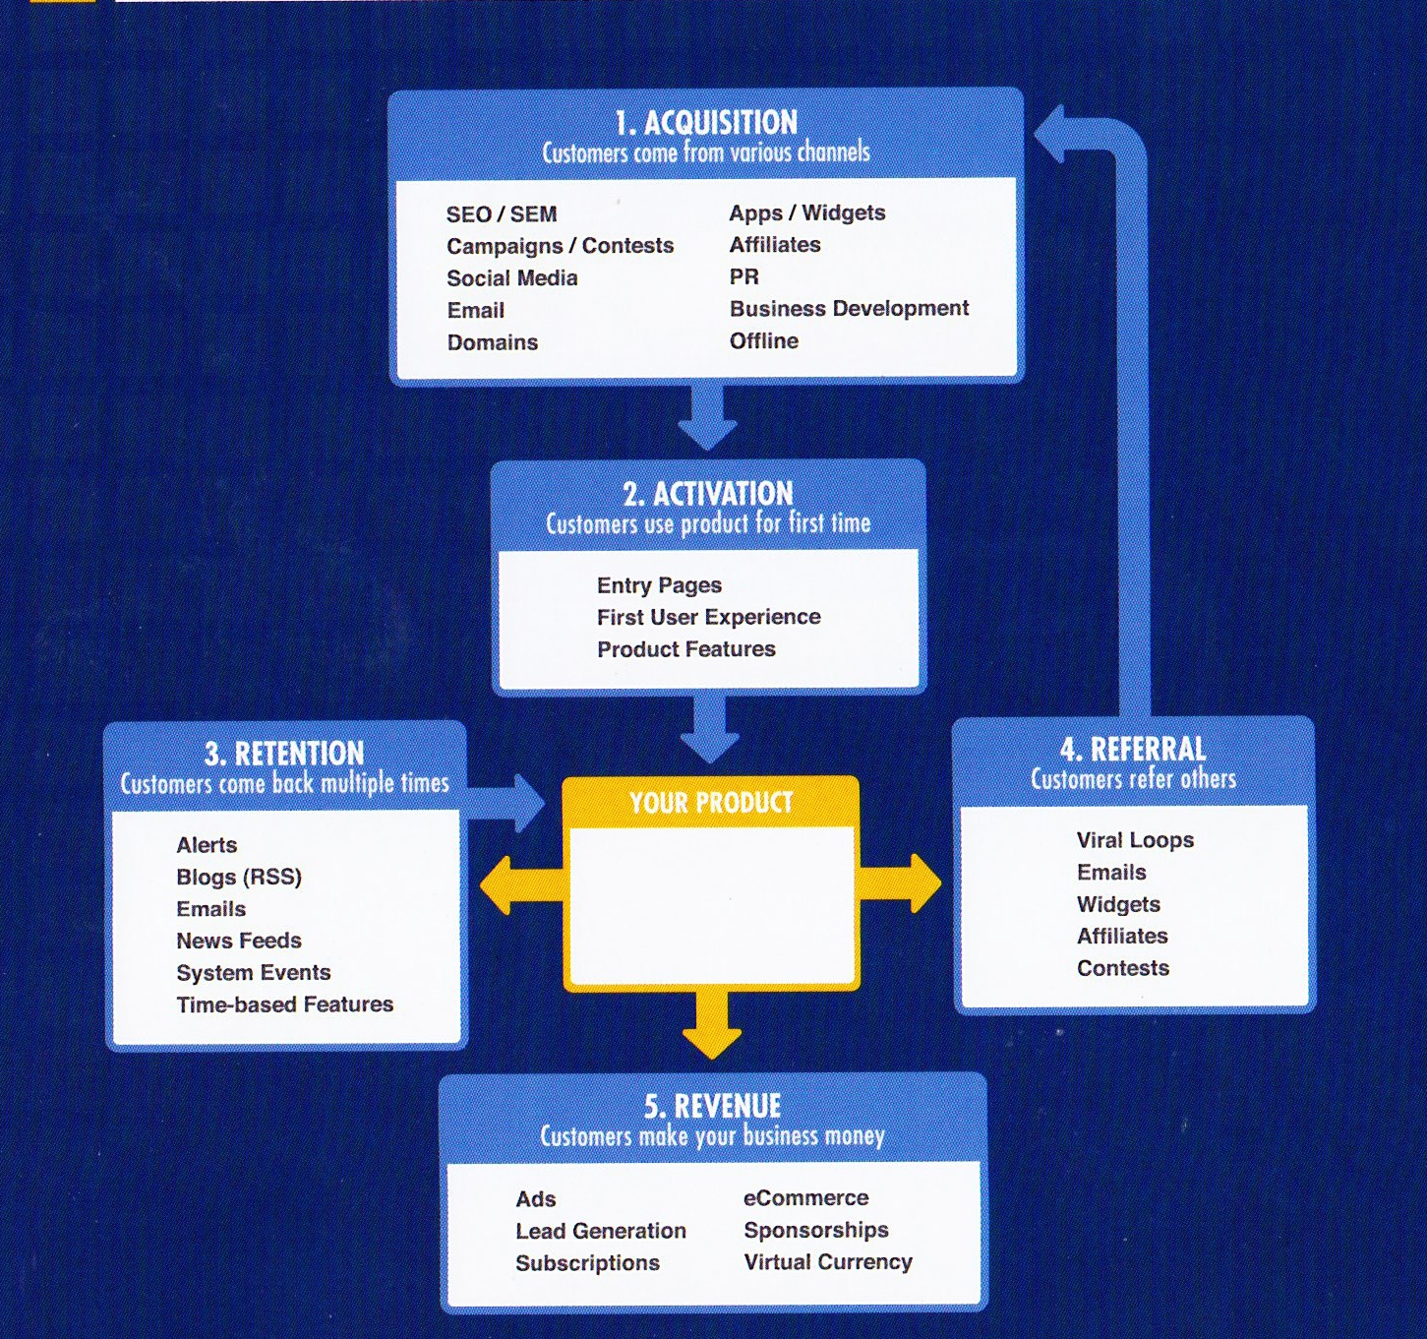
Pirate Metrics
Copyright David McLure
500hats.com
Courtesy of KISS Metrics

Slide 59
Vanity Metrics
Web traffic
Unique visitors
Return rate
Subscribers/users
Conversion Rate
Churn

Slide 60
Example
www.phildub.com
What does he want?
Does the web traffic help him?

Slide 61



How to get metrics?
Get started right away
  For Inbound Marketing you have several choices
  (that you can mix and match)
  KISS Metrics
  Hootsuite
  Hubspot
  For engagement
  Design your product so that you can collect the metrics you need (even if you need to embed a small cloud app)
  For CAC and LTV
  Design you management system to collect this data

Slide 62
Marketing Execution & Budget
How many of you have a product that sells itself?
If not, how will you spend your marketing budget?

Slide 63
Market Segment Fit
Marketing Methods
For each segment, identify which methods you will use. (this will depend on the Pros/Cons for your solution/segment combinations)
Then prioritize each method for each segment
For Priority segments create a budget

Slide 64
For each Segment – Create a Budget
 | Marketing Method | Segment 1 | Budget | Segment 2 | Budget
1 | Traditional Advertising
2 | Events
3 | Public Relations
4 | Corporate Communications
5 | Direct Mail
6 | Web Presence
7 | Mobile
8 | Search Engine Optimization
9 | Content
10 | Email Marketing
11 | Social Media
12 | Search Engine Marketing
13 | Internet Advertising
 | Total For Year 1

Slide 65
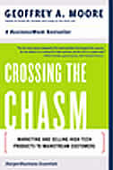

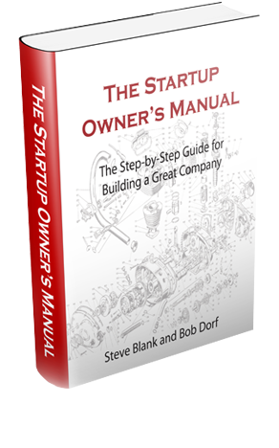

Resources – Reading Material
First customer to first market
Users and revenue
Targeted marketing

Slide 66
Dave Thomas 604-603-8630
dthomas@rocketbuilders.com
www.rocketbuilders.com
Ready to Rocket and Emerging Rockets
Past NVBC award winners
http://www.readytorocket.com/

